Slide 1
Pixel Shuffling
August 2024
Digital Image Processing Project
Arash Rasouli
Abolfazl Asad

Slide 2
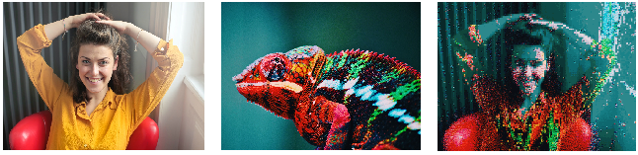
Introduction
Shuffle the source image’s pixel to create the second one
Split the image into blocks and calculate their average
Match blocks by using Balanced Assignment algorithm

Slide 3
Improvements

Slide 4
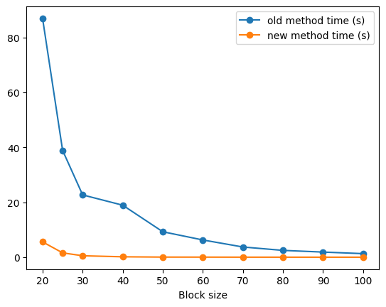
Improvements-Speed
Change loop computations to matrix computations
Reach from order O(n^4) to O(n^3)
Bottle-neck O(n^3)

Slide 5
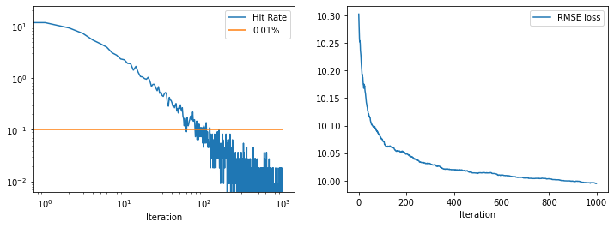
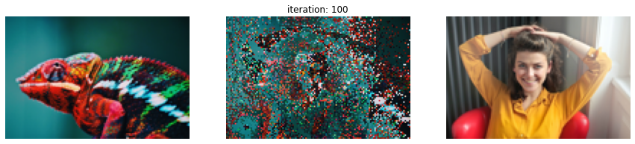

Improvements-Quality (Global - Low Resolution)
Create high quality Images by moving pixels

Slide 6
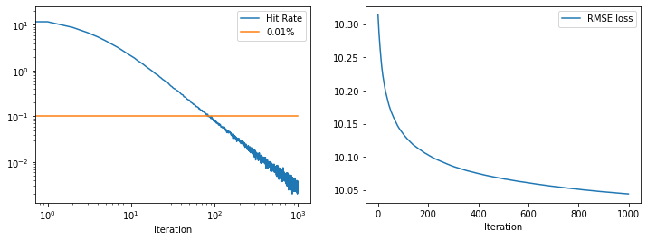

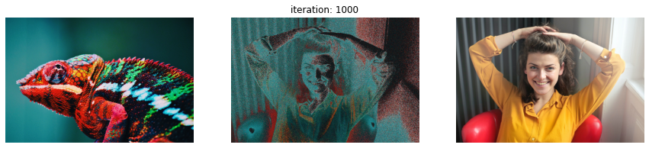
Improvements-Quality (Global - High Resolution)
Create high-quality Images by moving pixels

Slide 7
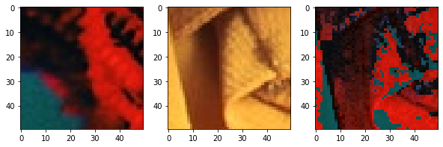
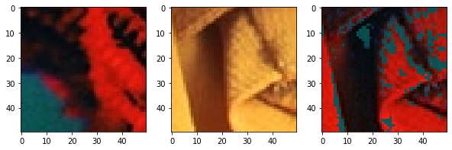
Improvements-Quality (Local)
Create high-quality blocks by moving pixels
Remove mean

Slide 8
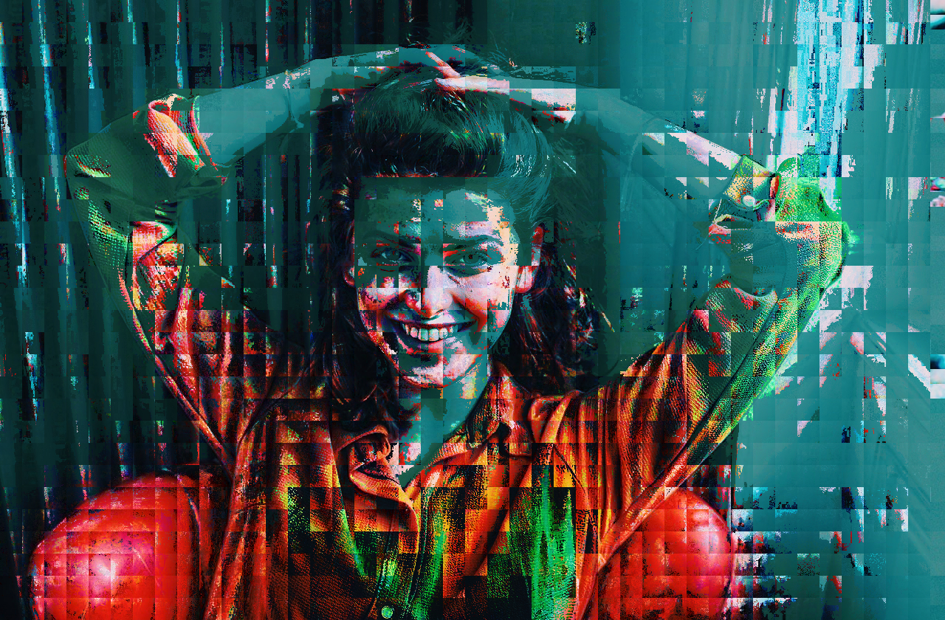

Improvements-Quality (Local)
First: Match Blocks
Then: Improve Quality locally

Slide 9
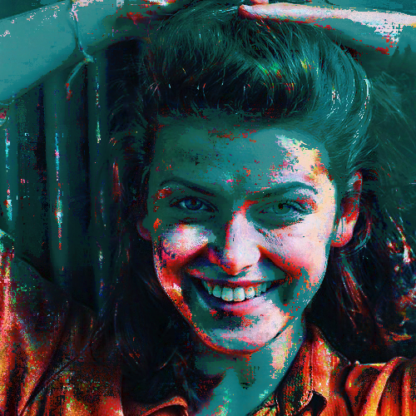
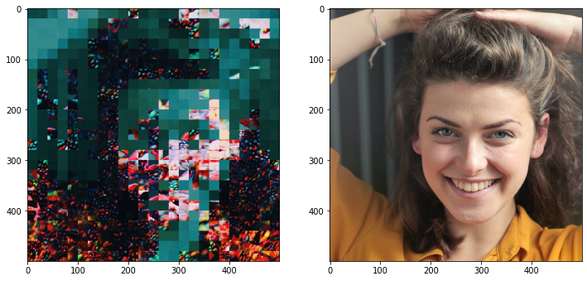
Improvements-Quality (Local)
Fix the output grid problem by using a smaller stride.

Slide 10

Improvements-Quality (Local)

Slide 11
Applications

Slide 12
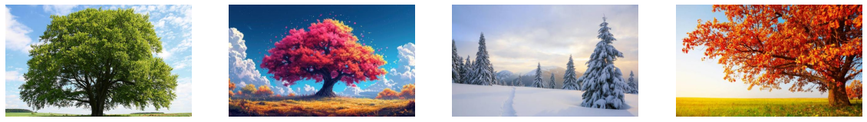
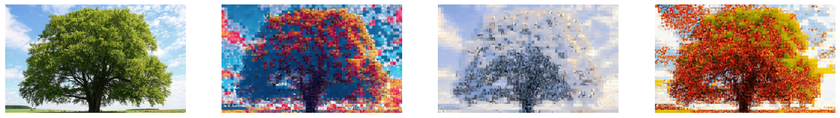
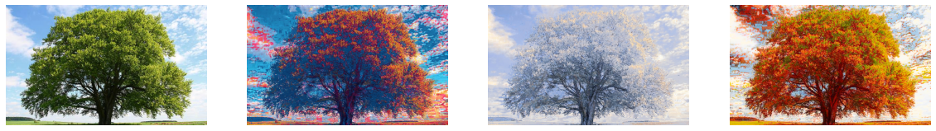
Applications-Domain changing
Change the domain of an image using source images

Slide 13

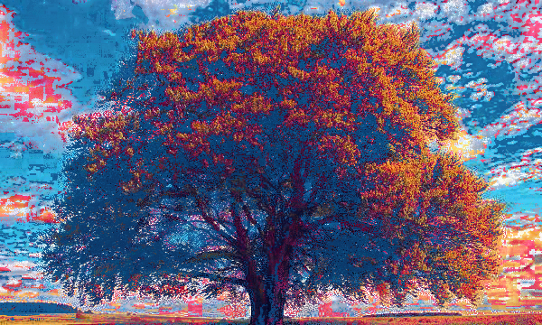
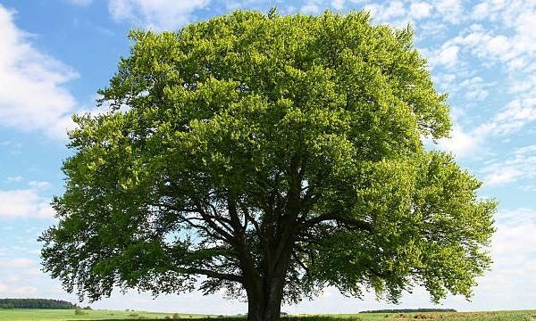
Applications-Domain changing
Change the domain of an image using source images

Slide 14
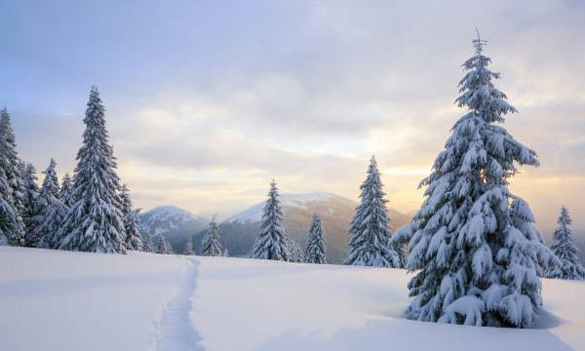
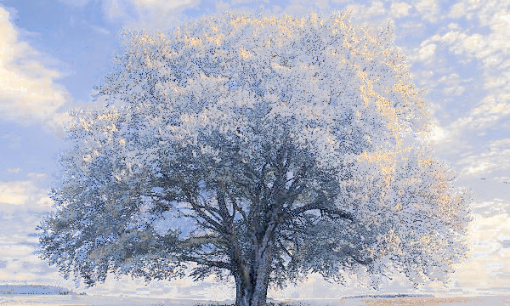
Applications-Domain changing
Change the domain of an image using source images

Slide 15

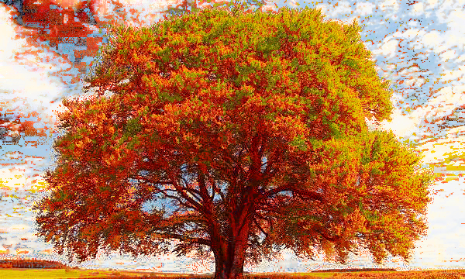
Applications-Domain changing
Change the domain of an image using source images

Slide 16
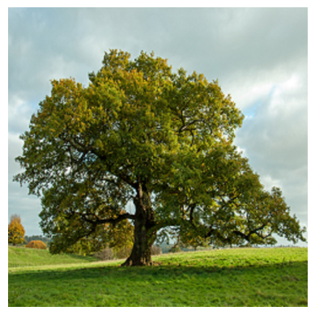
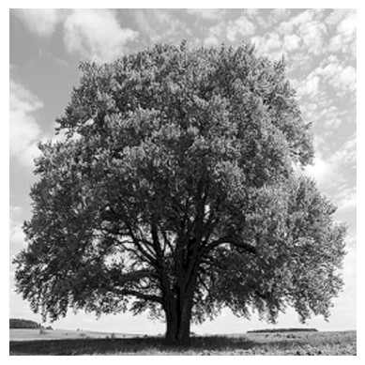
Applications-Colorizing
Colorize a grayscale image
Find same distribution color image

Slide 17
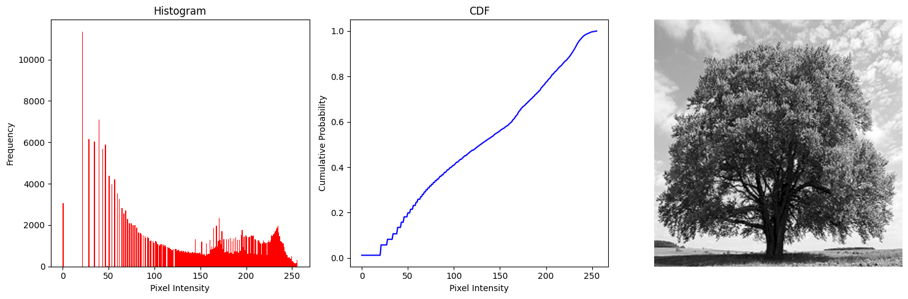
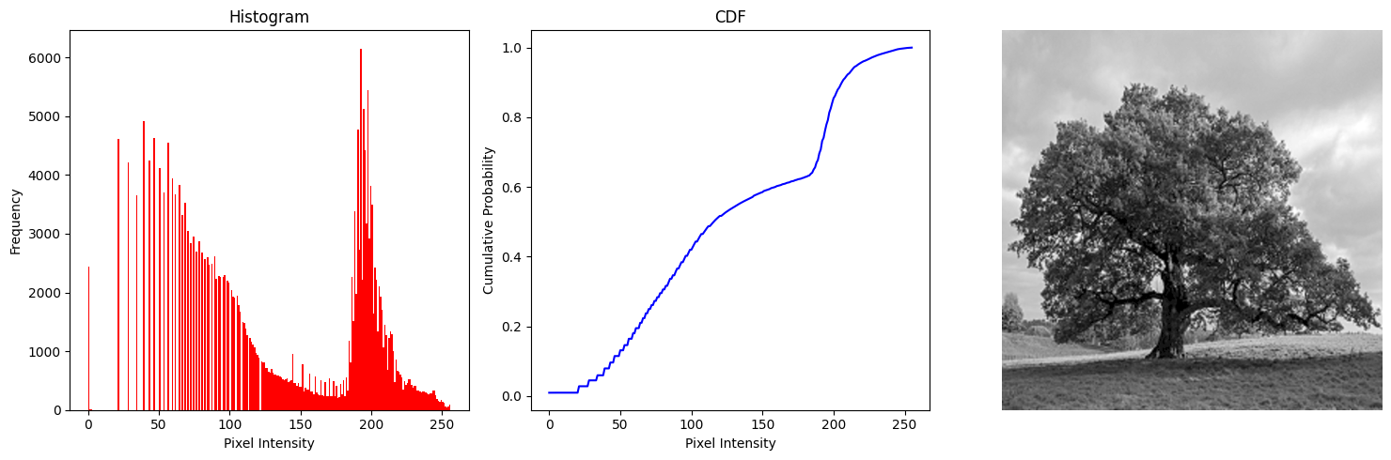
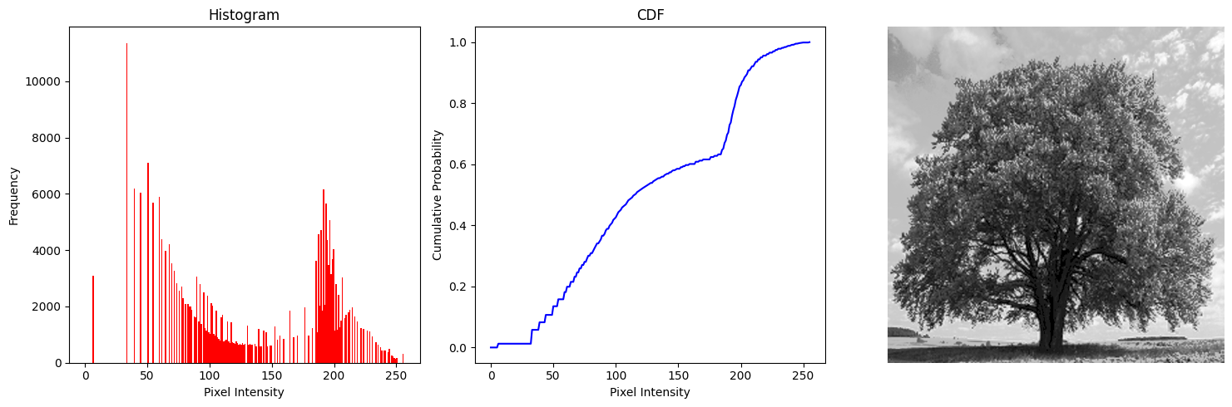
Applications-Colorizing
Matching histograms

Slide 18
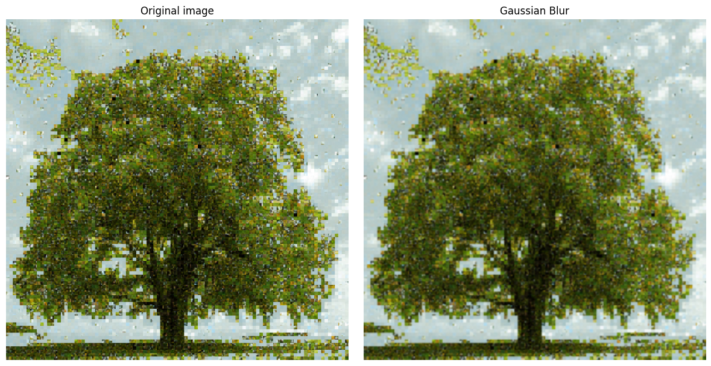
Applications-Colorizing
Apply algorithm and get coordinate matrix
Use coordinate to shuffle color pixels
Apply blur to have better image

Slide 19
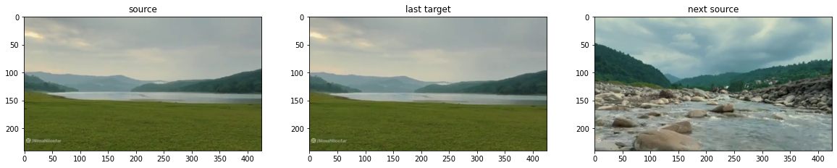
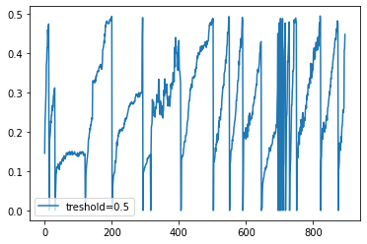
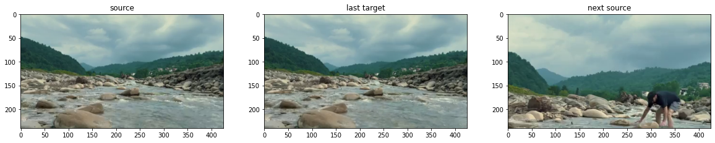
Applications-Video Compression
Cluster the frames based on histogram differences
Create each frame in cluster based on source image

Slide 20
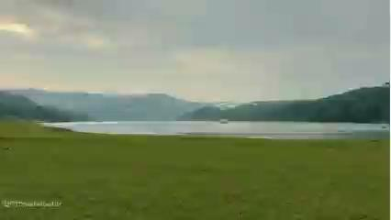
Applications-Video Compression
Reach 92% Compression
It can be used for video preview

Slide 21
Conclusion
Improve speed and quality
Find creative applications
Limitations
High computational cost for high-resolution images and small block size
Future work
Apply more improvement to reduce computational cost
Can be used in other applications like Cryptography

Slide 22
References
[1] https://github.com/rishi1999/pixel-shuffle.git
[2] https://en.wikipedia.org/wiki/Histogram_matching
[3] https://en.wikipedia.org/wiki/Assignment_problem#Balanced_assignment
[4] D. F. Crouse, "On implementing 2D rectangular assignment algorithms," in IEEE Transactions on Aerospace and Electronic Systems, vol. 52, no. 4, pp. 1679-1696, August 2016, doi: 10.1109/TAES.2016.140952

Slide 23
Thanks

